Slide 1
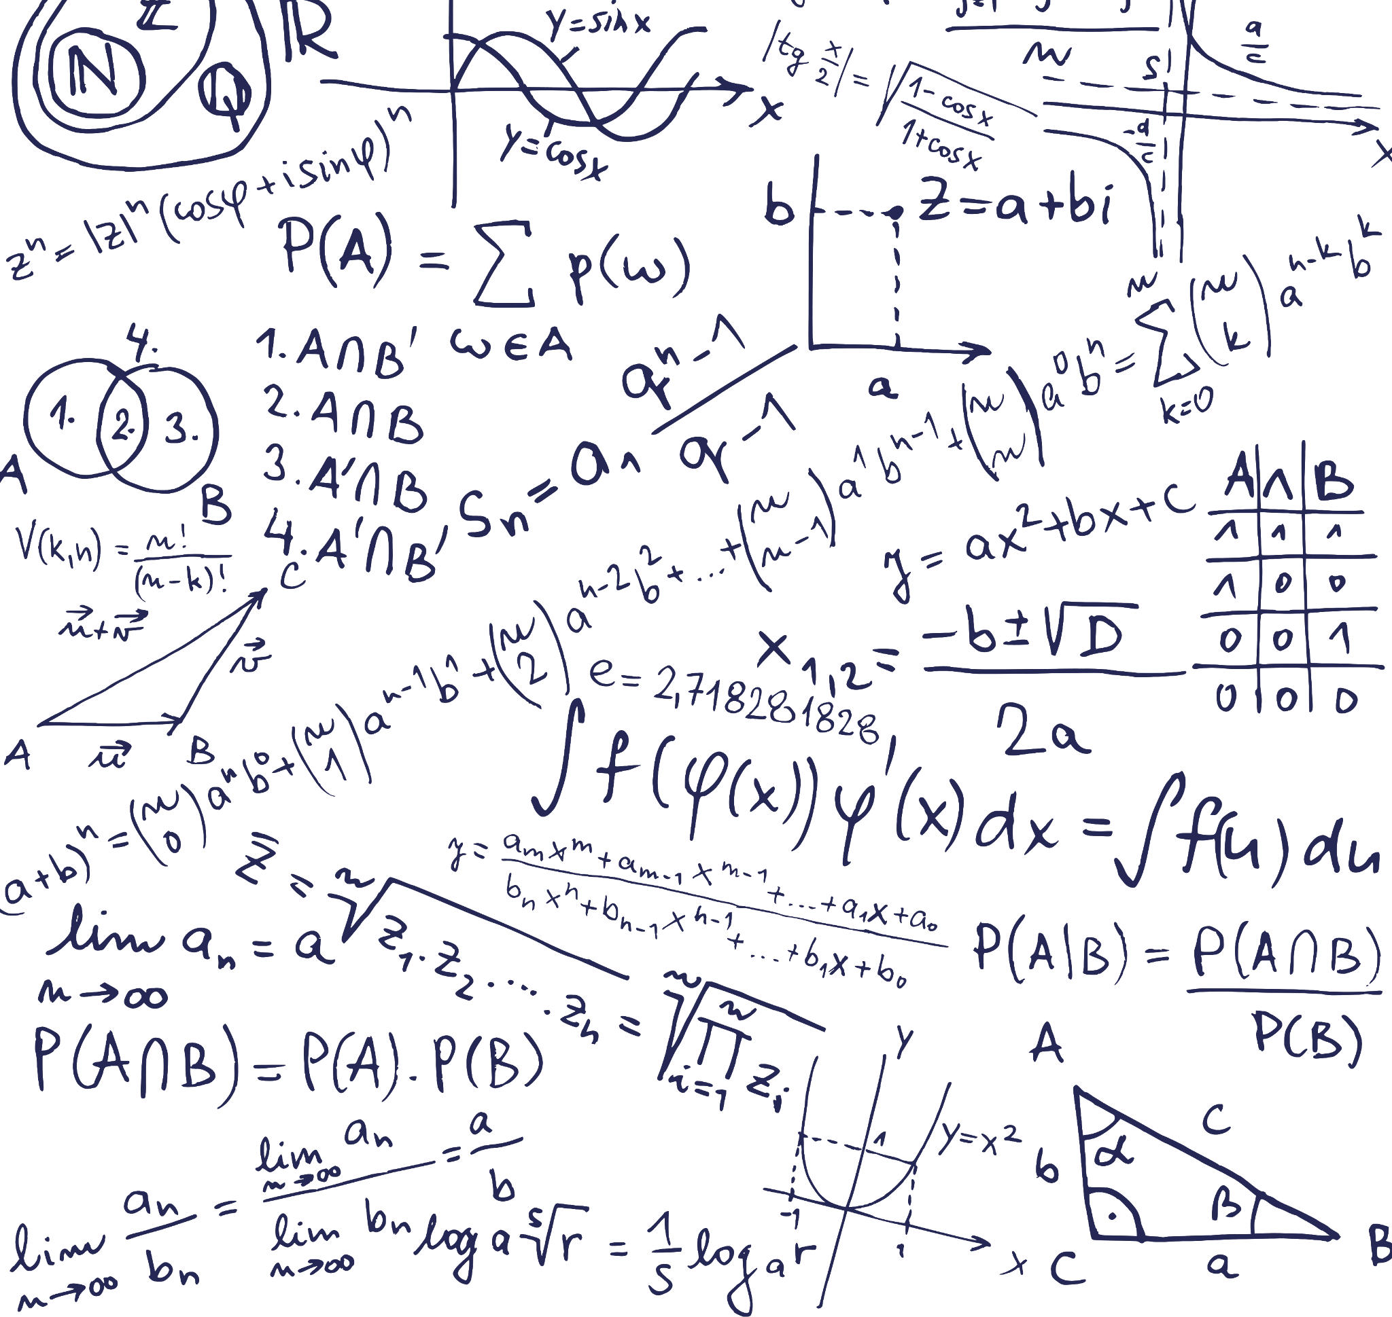
Common Child
No class snobbery here then.

Slide 2
The Problem
A Solution
A string is said to be a child of a another string if it can be formed by deleting 0 or more characters from the other string. Letters cannot be rearranged. Given two strings of equal length, what's the longest string that can be constructed such
that it is a child of both?
'''
Class: PascalCase
Function: camelCase
Variables: snake_case
Static Variables: UPPER_SNAKE_CASE
PEP 8: can go forth and multiply with itself
'''
class Solution: def streetUrchin(self, a: int, b: int) -> int:
buckets: list = [0 for _ in range(len(a))]
for i in range(len(a)):
pan_galactic_gargle_blaster: int = 0
bucket: int = 0
for j in range(len(b)):
if a[i] == b[j]:
intergalactic_gargle_blaster = bucket + 1
bucket = buckets[j]
buckets[j] = max(pan_galactic_gargle_blaster, buckets[j] )
Return buckets[len(a) - 1]
s1 = 'ABCD'
s2 = 'ABDC'
These strings have two children with maximum length 3, ABC and ABD. They can be formed by eliminating either the D or C from both strings. Return .
Not sticking to the pep 8 style guide
Let me fix that
And blar bar bar
But how do we get here?
Stop falling asleep at your desk
Don't panic, we will come back to the code. And then you can panic.

Slide 3
With the power of buckets and bean bags
Finding When Letters Match
'ABCD'
'ABDC'
class Solution: def letterMatch(self, a: int, b: int) -> int:
buckets: list = [[False for _ in range(len(a))] for _ in range(len(b))]
for i in range(len(a)):
for j in range(len(b)):
if a[i] == b[j]:
buckets = True
# else:
# buckets = False
When you have two strings of four, there are sixteen possible matches. 4*4. So we have 16 buckets set out in a 4 by 4.
A B D C
A
B
C
D
X
X
X
X
And then we put a bean bag in a bucket that has a match. That’s it.
We compare each element of the first string with each element of the second string. So A is compared to A, B, C, and D. Then B is compared to A, B, C, and D. This is describing a nested Loop.
But that’s 4 bean bags, and not 3

Slide 4
Breaking It Down
S1 = 'ABCD'
S2 = 'ABDC'
Removing Bags
Adding Bags
First row ‘A’ matches with the first bucket ‘A’
Put a bag in the first bucket on the top line. Then remove from the following buckets pm the top line.
x _ _ _
_ _ _ _
_ _ _ _
_ _ _ _
Add a bag in the first bucket on the top line. Then following buckets have a minimum of 1
1 1 1 1
0 0 0 0
0 0 0 0
0 0 0 0
Second row ‘B’ matches with the second bucket ‘B’
Copy the top line to the second line. Then starting on the second bucket on the second line, repeat the above.
x _ _ _
x x _ _
_ _ _ _
_ _ _ _
Copy the top line to the second line. Then starting on the second bucket on the second line, repeat the above. Minimum being 2
1 1 1 1
1 2 2 2
0 0 0 0
0 0 0 0
Third row ‘A’ matches with the fourth bucket ‘A’
Same as above
x _ _ _
x x _ _
x x _ x
_ _ _ _
Same as above
1 1 1 1
1 2 2 2
1 2 2 3
0 0 0 0
x _ _ _
x x _ _
x x _ x
x x x _
Adding to the 3rd bucket that has a value of 2, setting the minimum to 3. This doesn't change the value of the 4th bucket on the 4th line.
1 1 1 1
1 2 2 2
1 2 2 3
1 2 3 3
Fourth row ‘A’ matches with the third bucket ‘A’
This time on the 4th bucket on the 4th line, you can see that the bag has been removed.
I don't have this solution working

Slide 5
The code
S1 = 'ABCD'
S2 = 'ABDC'
In both solutions, we are copying a row of buckets to the next row. If there isn't a row to copy, or a row to copy to, the program will fall over.
IndexError: list index out of range
Removing Bags
So we add more buckets with: range(len(b) + 1).
It’s the +1
Adding Bags
class Solution: def takeBag(self, a: int, b: int) -> int:
buckets: list = [[False for _ in range(len(a))] for _ in range(len(b) + 1)]
for i in range(len(a)):
matched = False
for j in range(len(b)):
If match == True:
buckets[i][j] = False
elif a[i] == b[j]:
buckets[i][j] = True
matched = True
buckets[i+1] = buckets[i].copy()
return sum(buckets[len(b)])
class Solution: def giveBag(self, a: int, b: int) -> int:
buckets: list = [[0 for _ in range(len(a) + 1)] for _ in range(len(b) + 1)]
for i in range(len(a)):
buckets[i+1] = buckets[i].copy()
for j in range(len(b)):
If a[i] == b[j]:
buckets[i + 1][j + 1] = buckets[i + 1][j + 1] + 1
else a[i] == b[j]:
buckets[i + 1][j + 1] = max(buckets[i + 1][j], buckets[i][j + 1])
return buckets[len(a)][len(b)]
Disclaimer. I have not worked out how to deal with all the edge cases for the above code
On this solution not only can we copy the above bucket down, but we can also copy the previous bucket on that row.
Remember “following buckets have a minimum of _”
above_bucket = buckets[i + 1][j]
pervious_bucet = buckets[i][j + 1]
It would of been a smart idea to rename them in the code. Well done me for being an idiot.
And both fail on edge cases.
Oh yeah. range(len(a) + 1), else indexError

Slide 6
Edge Cases
Here is where we split the programmers from the script kiddies
Now You Can Panic
Removing Bags
Adding Bags
Because we are emptying buckets, we are not tracking all potential matches.
_ x _ _
x _ _ _
x _ _ _
x x _ _
x x _ _
S1 = ABBA
S2 = BAAB
Sub = AB or BA
Out = 2
0 0 0 0 0
0 0 1 1 1
0 1 1 1 2
0 2 2 2 2
0 2 3 3 3
When S1 has 2 or more of the same letter, that also match with at least one letter of S2, it over counts.
Right answer.. But we are under counting on the second row
Over counting.
x _ _ _
x x _ _
x x x _
x _ _ _
x _ _ _
S1 = ABCA
S2 = ABCD
Sub = ABC
Out = 3
0 0 0 0 0
0 1 1 1 1
0 1 2 2 2
0 2 2 3 3
0 2 2 3 3
This happens because we add one to the value of the above bucket
Wrong answer, but this can be fix with a max_total
Over counting again.
I am yet to work out how to get round this problem with this code.
_ _ _ _
_ _ _ _
_ x _ _
x _ _ _
x _ _ _
0 1 2 2 2
0 2 2 2 2
S1 = NJAB
S2 = BADB
Sub = AB
Out = 2
0 0 0 0 0
0 0 0 0 0
0 0 0 0 0
0 0 1 1 1
0 0 1 1 2
Under counting again.
1 out of 3.
We are adding to the wrong bucket
Now for the really hard bit
0 1 2 2 2
0 1 2 2 2

Slide 7
Fix the code
The code at the start.
You are not going to like this
class Solution: def streetUrchin(self, a: int, b: int) -> int:
buckets: list = [0 for _ in range(len(a))]
for i in range(len(a)):
pan_galactic_gargle_blaster: int = 0
bucket: int = 0
for j in range(len(b)):
if a[i] == b[j]:
intergalactic_gargle_blaster = bucket + 1
bucket = buckets[j]
buckets[j] = max(pan_galactic_gargle_blaster, buckets[j] )
Return buckets[len(a) - 1]
class Solution: def giveBag(self, a: int, b: int) -> int:
buckets: list = [[0 for _ in range(len(a) + 1)] for _ in range(len(b) + 1)]
for i in range(len(a)):
buckets[i+1] = buckets[i].copy()
for j in range(len(b)):
If a[i] == b[j]:
# Change this
# buckets[i + 1][j + 1] = buckets[i + 1][j + 1] + 1
# To this
buckets[i + 1][j + 1] = buckets[i][j] + 1
else a[i] == b[j]:
buckets[i + 1][j + 1] = max(buckets[i + 1][j], buckets[i][j + 1])
return buckets[len(a)][len(b)]
It’s more or less the same code. It doesn’t use a 2D list, but that’s about it. I just like the way it looks over the other code.
It should have been buckets[i + 1][j + 1] = buckets[i][j + 1] + 1. But because buckets[i+1] is a copy of buckets[i].
In this case buckets[i + 1][j + 1] is the same as buckets[i][j + 1]
I am just too lazy to remember if its j or i I have to +1 to
This isn’t the only solution.
And both fail on edge cases.
Oh yeah. range(len(a) + 1), else indexError

